Slide 1

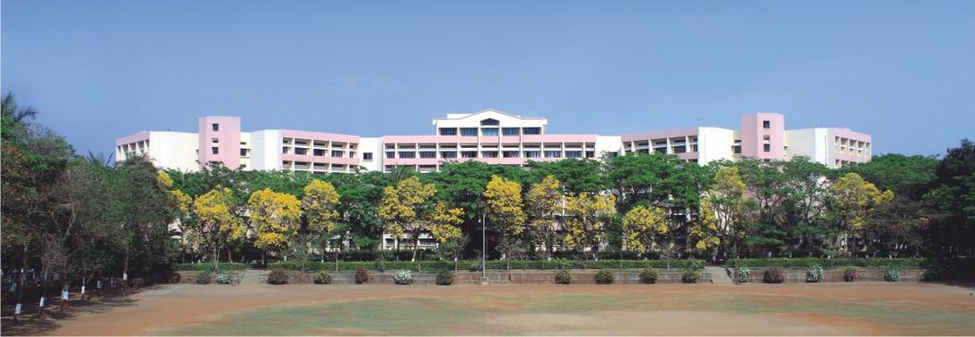

Click icon to add picture
K. K. Wagh Institute of Engineering Education & Research
HealthSync: Smartcare Companion
Group Id : 14
Internal Guide : Prof. V.P.Channe

Slide 2
Team members
Division./ Roll No. | Name of the student | Email ID | Contact Number
A/53 | Radhika A. Ware | raware371322@kkwagh.edu.in. | 8482866073
A/54 | Krishna S. Wable | kswable371322@kkwagh.edu.in | 9623082674
A/55 | Bhumika R. Raut | brraut371322@kkwagh.edu.in | 7498717259
A/56 | Achal P. Patil | appatil011221@kkwagh.edu.in | 9834591172

Slide 3

Index
Introduction
Problem Definition
Objective
Literature Review
Methodology (Block diagram,Proposed approach,Techniques,tools, Detailed Design)
Expected Outcomes
Summary
References
3

Slide 4
Introduction :
HealthSync: SmartCare Companion filters food options based on allergies and diseases, and suggests safe home remedies for mild symptoms through smart rule-based filtering.It predicts daily calorie and nutrient needs using fuzzy logic with TOPSIS/AHP, adapting to changing lifestyles.
An ontology-powered food knowledge graph maps links between food, nutrients, and diseases for better meal suggestions.
Progress is tracked over time with time-series models, showing how diet and habits impact health.It is hybrid system detects symptom patterns, predicts issues, and triggers threshold-based alerts.
Meal plans evolve through reinforcement learning, becoming more personalized with use. All techniques work together in a user-friendly app, helping individuals manage wellness with intelligent, tailored support.
3

Slide 5
Problem Definition:
People often struggle with managing diet and health due to generic advice, lack of symptom tracking, and delayed medical intervention. There's a need for a smart, easy-to-use system that offers personalized diet plans, tracks symptoms, monitors recovery, and provides smart and reliable health consultations. Most current apps are either too basic or not health-aware. HealthSync: SmartCare Companion aims to solve this by delivering tailored nutrition advice, symptom monitoring, recovery tracking, and doctor visit alerts—all through a friendly, intelligent interface which uses techniques like rule based screening, fuzzy logic with TOPSIS/AHP, ontology powered food KG, threshold based alerts and reinforcement learning.
3

Slide 6
Scope and Objectives:
Personalized Diet Plans : Provide tailored diet recommendations based on health conditions.
Symptom Tracking : Monitor symptoms and suggest dietary adjustments.
Health Progress Monitoring : Track recovery and optimize diet accordingly.
AI Health Consultation : Offer remedies for mild health issues.
Doctor Visit Alerts : Recommend medical attention for severe symptoms.
User-Friendly Interface : Ensure accessibility for all users.
3

Slide 7
Literature Review
Sr. No | Title | Authors | Description | Limitations
1. | OBESEYE: Interpretable Diet Recommender[1] (Year: 2023) – IJRAMT | Mrinmoy Roy ; Srabonti Das ; Anica Tasnim Protity | Obesity management and nutrient prediction for NCD patients. Predicts individual fluid, fat, protein, and carb intake using health data. | Small dataset; scope for more nutrition factors
2. | DIET RECOMMENDATION SYSTEM USING MACHINE LEARNING[2] (Year: 2023) – Dogo Rangsang Research Journal | Reema Golagana ; V. Sravani ; T. Mohan Reddy ; CH Kavitha | Limited personalization and static data usage problem. Does pattern prediction using preprocessed USDA & real user data. | Not real-time, lacks dynamic feedback and explainability
3. | Personalized Flexible Meal Planning for Individuals With Diet-Related Health Concerns [3] (Year: 2023) – JMIR Formative Research | Maryam Amiri, MSc ; Juan Li, PhD ; Wordh Hasan, MSc | Personalization for diabetes, hypertension, etc. Flexible meal planning using semantic and fuzzy reasoning. | Needs dynamic, real-time adjustments and cultural/personal factors
4. | Healthy and time-aware food recommender system using attributed community detection[4] (Year: 2023) - IEEE published | Mehrdad Rostami; Mourad Oussalah ; Vahid Farrahi ; Sajad Ahmadian ; Seyed Mohammad Jafar Jalali | Lack of nutritional focus & time-aware food suggestions is faced by many people. Attributed community detection with time-aware collaborative filtering | Needs deeper personalization & scalability

Slide 8
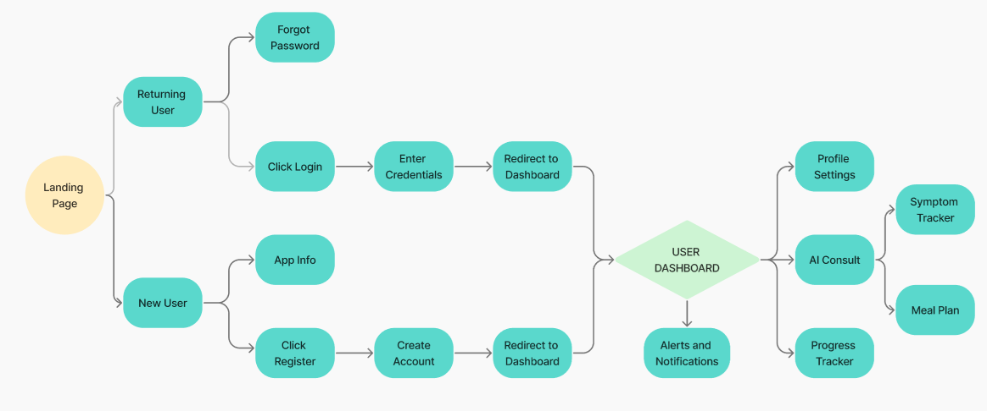
Methodology
User Flow Block Diagram:
3

Slide 9
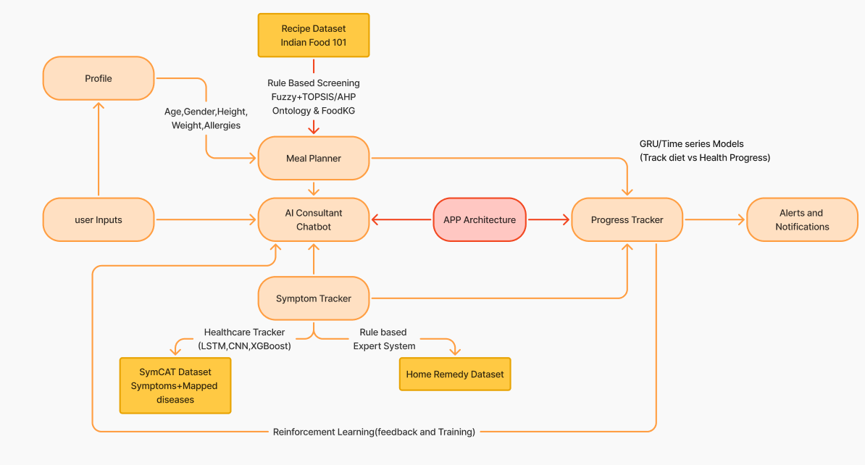
Methodology
Architecture:
3

Slide 10
Methodology
Proposed Approach :
Collect user profile (age, BMI, conditions).
Filter meals using rules + FoodKG.
Generate diet via Fuzzy + TOPSIS/AHP.
Chatbot gives personalized health advice.
Track symptoms using ML (LSTM, CNN).
Suggest home remedies for mild issues.
Monitor progress using time series models.
Send alerts for serious health conditions.
Improve system via user feedback (RL)

Slide 11
Methodology
Technologies :
Rule-Based Filtering Filters food options based on user constraints like allergies, religious preferences, and existing diseases.
Fuzzy + TOPSIS/AHP Predict daily calorie and nutrient requirements.
Ontology & FoodKG (Knowledge Graph) Understand relationships between food items, nutrients, and diseases.
GRU / LSTM (Time Series Models) Monitor user progress over time and assess impact of diet on health.

Slide 12
Methodology
Technologies :
CNN + LSTM + XGBoost (Hybrid Health Tracker) Detect symptom patterns and predict possible health issues.
Rule-Based Expert System (for Home Remedies) Suggest natural remedies for common symptoms like cold, headache, etc.
Reinforcement Learning (RL) Improve meal plan recommendations over time.
Threshold-Based Alert System Alert user to seek medical attention if symptoms are severe.

Slide 13
Requirement Specifications
Tools and Languages :
Frontend: React.js + Tailwind CSS(for responsiveness)
Backend: Python (Flask or Django)
Database: MongoDB or MySQL
AI Models: Trained in Python (Scikit-learn, TensorFlow, or PyTorch)
APIs: RESTful APIs for interaction between frontend and backend
Authentication: JWT or session-based login

Slide 14
Expected Outcomes
Personalized and Adaptive Diet Plans: The system delivers tailored nutritional guidance based on user-specific data such as age, BMI, and medical conditions, dynamically adjusting recommendations using AI and symptom tracking.
AI-Powered Symptom Monitoring and Consultation: Through machine learning models (LSTM, CNN) and a built-in chatbot, users receive real-time symptom analysis, health advice, and home remedy suggestions for minor ailments.
Health Progress Tracking and Recovery Support: The app continuously monitors recovery using time series models and provides users with visual feedback on their health improvements over time.
Proactive Health Alerts and Medical Guidance: HealthSync identifies critical symptoms and sends timely alerts to encourage professional medical consultation, bridging the gap between self-care and clinical attention.
Secure, User-Friendly, and Self-Learning Platform: With a responsive interface, secure login (JWT/session), and reinforcement learning capabilities, the system enhances user engagement while continuously improving its accuracy and relevance.

Slide 15
Summary
HealthSync: SmartCare Companion is an AI-powered health and nutrition management system designed to provide personalized diet plans, real-time symptom tracking, and intelligent health consultations. By collecting user data such as age, BMI, and medical conditions, the system filters meals using rule-based logic and a Food Knowledge Graph, and applies decision-making techniques like Fuzzy Logic with TOPSIS or AHP for optimal diet generation. It features an interactive chatbot for personalized health advice, uses ML models like LSTM and CNN for symptom monitoring, and offers home remedies for mild issues. Time series models track recovery progress, while alerts are sent for serious health concerns. The system continuously improves through user feedback using reinforcement learning. Built with HTML5, CSS3, JavaScript, and Bootstrap/Tailwind on the frontend, and Python (Flask or Django) with MongoDB or MySQL on the backend, it uses RESTful APIs for communication and JWT/session-based authentication. HealthSync aims to intelligently bridge the gap between everyday wellness and timely medical attention through an adaptive, user-friendly interface.

Slide 16
References
1] Mrinmoy Roy, Srabonti Das, Anica Tasnim Protity, “OBESEYE: Interpretable Diet Recommender for Obesity Management using Machine Learning and Explainable AI”, 2023 : https://arxiv.org/pdf/2308.02796
2] Reema Golagana ,V. Sravani, T. Mohan Reddy ,CH Kavitha, “Diet Recommendation System using Machine Learning[2] Dogo Rangsang Research Journal”,2023: https://www.journal-dogorangsang.in/no_1_Online_23/20_apr.pdf
3] Maryam Amiri ,Juan Li, Wordh Hasan, “Personalized Flexible Meal
Planning for Individuals With Diet-Related Health Concerns: System Design and
Feasibility Validation Study”, 2023 : https://formative.jmir.org/2023/1/e46434/PDF
4] Mehrdad Rostami, Vahid Farrahi, Sajad Ahmadian, Seyed Mohammad Jafar Jalali, Mourad Oussalah, “A novel healthy and time-aware food recommender system using attributed community detection”,2023 : https://doi.org/10.1016/j.eswa.2023.119719

Slide 17
Thank You !!

